Slide 1
Methods of Research
Paper presentation
Ivan John Naparota | October 19, 2018

Slide 2
Optimizing the configuration of a façade module for office buildings by means of integrated thermal and lighting simulations in a total energy perspective
Francesco Goia, Matthias Haase, Marco Perino
Goia, F., Haase, M., & Perino, M. (2013). Optimizing the configuration of a façade module for office buildings by means of integrated thermal and lighting simulations in a total energy perspective. Applied Energy, 108, 515–527. https://doi.org/10.1016/j.apenergy.2013.02.063

Slide 3
Background
Finding the optimum façade configuration in low energy buildings (energy efficient buildings):
Mostly through analysis of cooling and/or heating energy demand only
Mostly neglecting its implication on the artificial lighting energy demand and visual environment
When dynamic solar shading is considered, there is complexity in thermal-lighting simulations

Slide 4
Goal
Present a methodology in finding the optimum façade configuration (window-wall ratio) through analyses of total energy demand (lighting, cooling, and heating) and visual environment in a low energy office building with dynamic solar shading.

Slide 5
Specific Objectives
To identify the optimum value of solar shading that will give the least total energy consumption
Simulate different activation set point of the solar shading device for every WWR value and orientation
Process output data from simulation and arrive to the optimum set point value for each WWR value and orientation; analyse the effect of different set points to ETOT
To identify the optimum value of window-wall ratio for every orientation that will give the least total energy consumption
Simulate different WWR values for every orientation applying the optimum set-points
Process output data from simulation and arrive to the optimum WWR value for every orientation
Analyse the behaviour of front façade with respect to the back façade
Compare worst and optimum WWR value with respect to ETOT
To analyse the implication of WWR values on the visual environment
Daylight Autonomy metric
Useful Day-light Illuminance metric
To test the robustness of the WWR value using sensitivity analysis
Sensitivity analysis of the optimum WWR value with varying surface area-to-volume ratio
Sensitivity analysis of the optimum WWR value with varying SCOP for heating and cooling

Slide 6
Experimental Flow Diagram
4 set-points
5 WWR
4 orientations
EH
EC
EL
Optimum
Set point
values
Simulation
Data process
EH
EC
EL
UDI
DA
2 coupled orientations
5 WWR front
5 WWR back
Data process
Simulation
Robustness
Analyse/Compare
Optimum WWR
Optimum WWR
Different SA:V
Different SCOP for heating/cooling

Slide 7

Experimental Design
To identify the optimum value of solar shading
Simulate different activation set point of the solar shading device for every WWR value and orientation
Baseline Model
4 set-points
5 WWR
4 orientations
EH
EC
EL

Slide 8

Experimental Design
To identify the optimum value of window-wall ratio for every orientation
Simulate different WWR values for every orientation applying the optimum set-points
To test the robustness of the WWR value
Sensitivity analysis of the optimum WWR value with varying surface area-to-volume ratio
Sensitivity analysis of the optimum WWR value with varying SCOP for heating and cooling
Optimum
Set point
values
EH
EC
EL
EH
EC
EL
2 coupled orientations
5 WWR front
5 WWR back
EH
EC
EL
B2: SA/V=.25
B1: SA/V=.20
B3: SA/V=.30
HVACeff = 2.6, 3.8
HVACeff = 2.6, 4.75 | 2.6, 2.85 | 3.25, 3.8 |1.95, 3.8

Slide 9

Experimental Design
To analyse the implication of WWR values to visual environment
Daylight Autonomy metric [32]
Useful Day-light Illuminance metric [33]
Optimum
Set point
values
Useful Daylight Illuminance
Daylight Autonomy
2 coupled orientations
5 WWR front
5 WWR back
B2: SA/V=.25
HVACeff = 2.6, 3.8

Slide 10
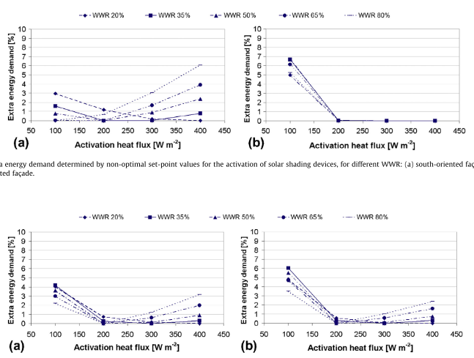
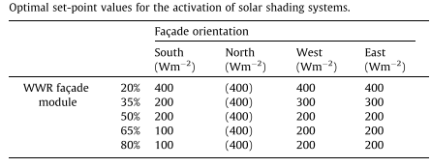
Information Flow Diagram
To identify the optimum value of solar shading
Process output data from simulation and arrive to the optimum set point value for each WWR value and orientation; analyse the effect of different set points to ETOT
Optimum Set point values
EH
EC
EL
Extra Energy Demand as a function of different activation set-points

Slide 11
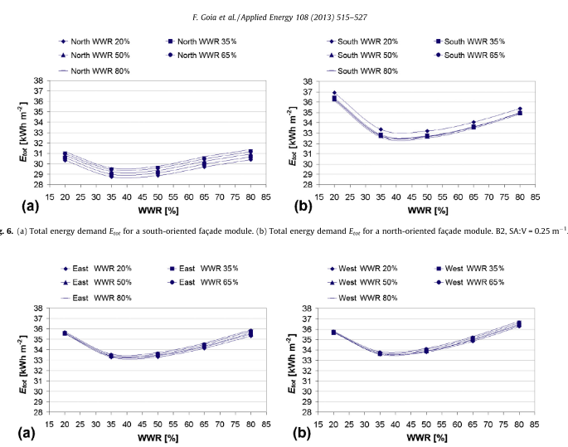
Information Flow Diagram
To identify the optimum value of window-wall ratio for every orientation
Simulate different WWR values for every orientation applying the optimum set-points
Process output data from simulation and arrive to the optimum WWR value for every orientation
Analyse the behaviour of front façade with respect to the back façade
Compare worst and optimum WWR value with respect to ETOT
EH
EC
EL
Optimum WWR
EH
EC
EL
Optimum WWR
ETOT
EH
EC
EL
Optimum WWR

Slide 12
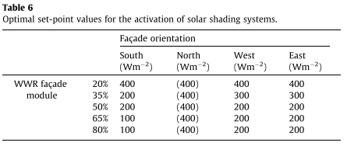
Results and Discussions
To identify the optimum value of solar shading and analyse its implications
Simulate different activation set point of the solar shading device for every WWR value and orientation
Process output data from simulation and arrive to the optimum set point value for each WWR value and orientation; analyse the effect of different set points to ETOT
Results:
Optimal set-point decreases as WWR value increases
No need for solar shading in the north façade

Slide 13
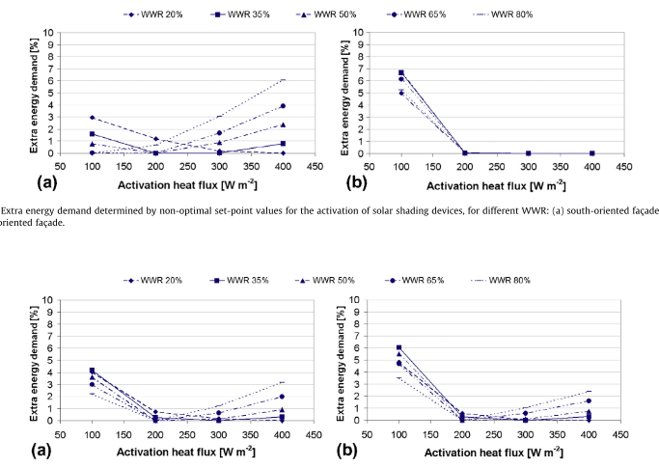
Results and Discussions
To identify the optimum value of solar shading and analyse its implications
Simulate different activation set point of the solar shading device for every WWR value and orientation
Process output data from simulation and arrive to the optimum set point value for each WWR value and orientation; analyse the effect of different set points to ETOT
Results:
South – 6% least to optimum difference
West – 3-4% least to optimum difference
East – 4-6% least to optimum difference

Slide 14
Results and Discussions
To identify the optimum value of window-wall ratio for every orientation
Simulate different WWR values for every orientation applying the optimum set-points
Process output data from simulation and arrive to the optimum WWR value for every orientation
Analyse the behaviour of front façade with respect to the back façade
Compare worst and optimum WWR value with respect to Etot
Results
Optimum WWR value is between 35-45%
Back facade WWR value has no significant effect on the performance
of front façade
South – optimal to worst = 6% difference | North – optimal to worst = 11% difference
West – optimal to worst = 7% difference | East – optimal to worst = 8-9% difference

Slide 15
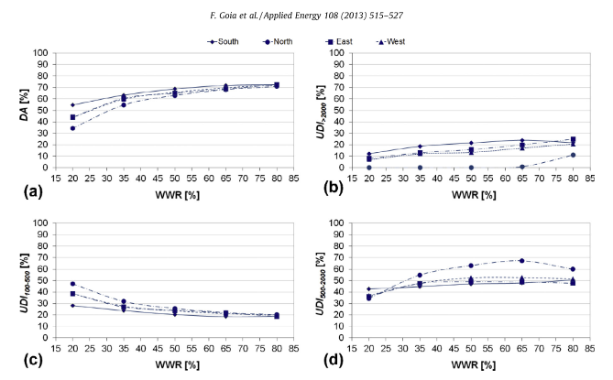
Results and Discussions
To analyse the implication of WWR values to the visual environment
Daylight Autonomy metric
Useful Day-light Illuminance metric
Results:
DA > 50% is obtained for façade configurations with WWR > 30% for every orientation
In the range where the optimal façade configurations lie (i.e. 35% < WWR < 50%), the UDI>2000 is about 20% for a south exposed façade, and about 12% in east/west exposed façades

Slide 16
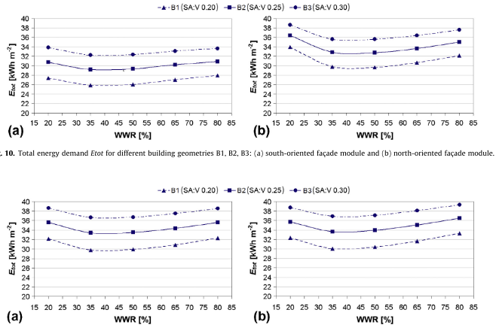
Results and Discussions
To test the robustness of the WWR value
Sensitivity analysis of the optimum WWR value with varying surface area-to-volume ratio
Sensitivity analysis of the optimum WWR value with varying SCOP for heating and cooling
Results:
The analysis points out that the building geometry affects the total energy demand. However, it also shows that the optimal WWR is independent from the building geometry.

Slide 17
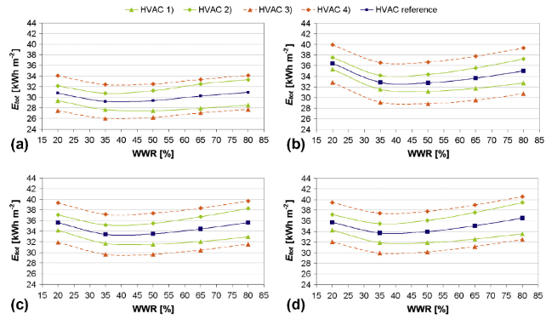
Results and Discussions
To test the robustness of the WWR value
Sensitivity analysis of the optimum WWR value with varying surface area-to-volume ratio
Sensitivity analysis of the optimum WWR value with varying SCOP for heating and cooling
Results:
The optimal WWR values are independent from the efficiency of the heating systems.
Higher efficiency of cooling tolerates a higher WWR value

Slide 18
Conclusion
WWR value has a low influence to the total energy consumption (Lighting, Cooling, Heating) of advanced façade module.
The minimum total primary energy demand is always achieved when WWR is in the range of 35–45%; and with satisfying day-lighting performance
The analyses show little dependence of Etot(WWR) on the building geometry and the HVAC efficiency
Set-point for solar shading will cause up to 11% more energy demand if not properly configured

